Slide 1
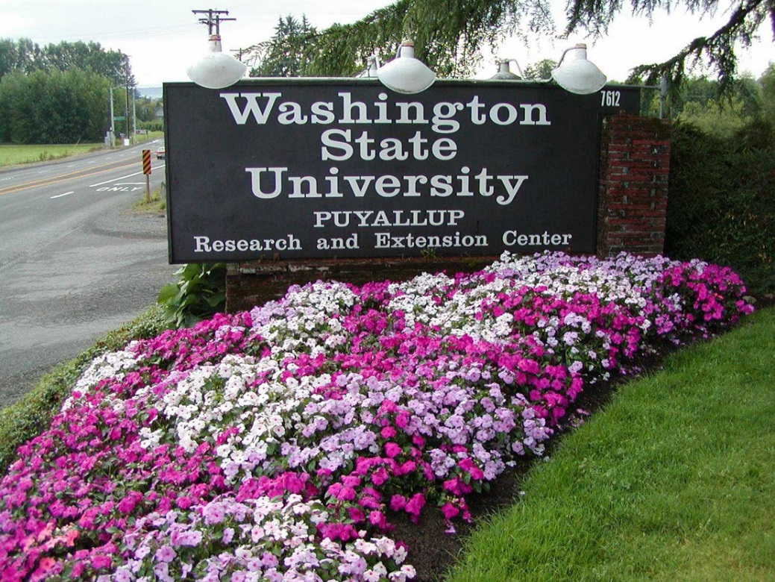
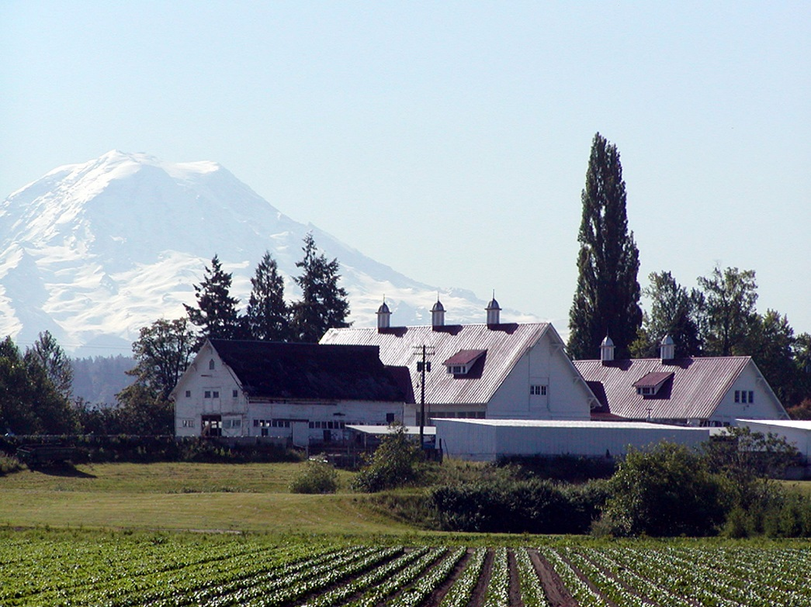
WSU Puyallup was established in 1894
Research and Extension Centers are part of the land grant mission

Slide 2
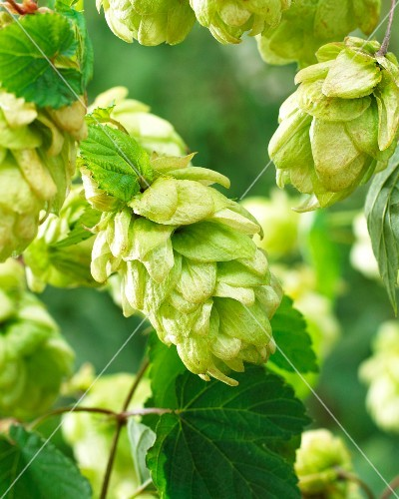
The original mission of the Puyallup R&E Center was to work on hops
Puyallup was the hops capital of the United States

Slide 3
As the area has urbanized
…..the Center has been refocused to work on stormwater, human health, and food safety and security
Notes:
Tle notes….Finding Purpose: Due to the increasing urbanization of the surrounding communities, and the disappearance of farmlands, the Center needed to re-focus and adapt to the changing needs of the Puget Sound. The Puyallup Center is rapidly creating and implementing water research and extension programs, changing its mission from agriculture to water as it continues to connect the research, extension, and teaching expertise of Washington State University to the Puget Sound region.

Slide 4
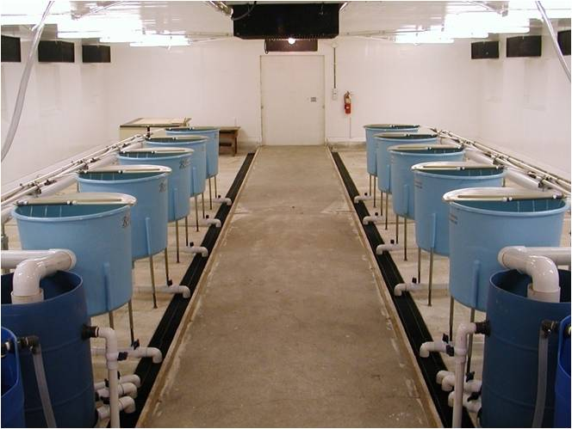
WSU-NOAA-USFW Salmon Lab
2004

Slide 5
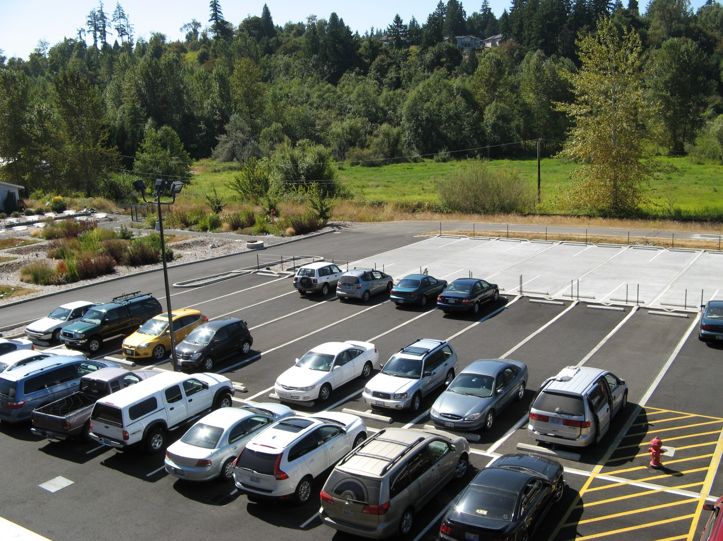
2008 – WSU-P receives $1 million to build large-scale LID research and education program

Slide 6
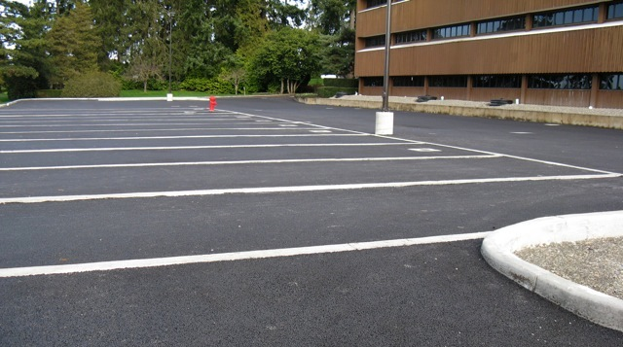
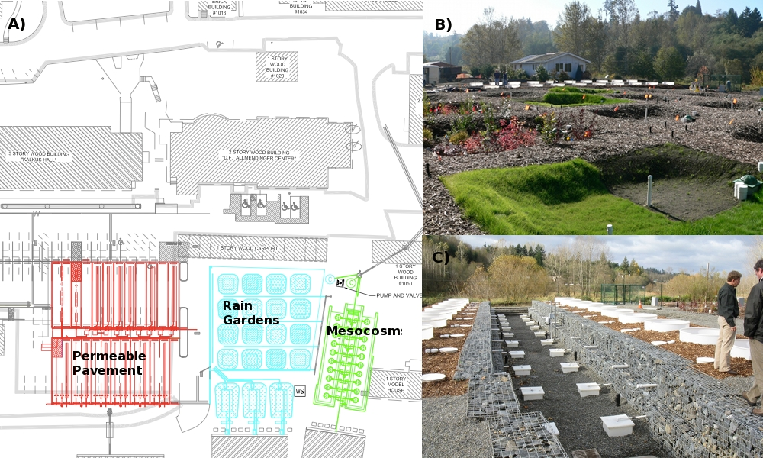
Washington State University: Puyallup GSI Facility
Permeable Pavement
Rain Gardens
Mesocosms

Slide 7
An Overview of the Washington Stormwater Center
John D. Stark, Ph.D.
Director, Washington Stormwater Center
Professor of Ecotoxicology
September 2018
Notes:
Tle notes…. What is the Puyallup Center?: Established along salmon-bearing Clark’s Creek in the Puyallup River watershed, Washington State University’s Puyallup Research and Extension Center is a fully operational mini-campus facility which has served the Puget Sound basin for over 100 years. The Puyallup Center, located in the heart of the Puget Sound basin which covers more than 16,000 square miles of land and water, was once was in the heart of agricultural production and is now circled by rapidly growing urban environments.
Notes from 2014 presentation……………Need to collapse slides to get down to stated 10 slides/presenter. Your next slide on Water Qual/Water Quan seemed to be something you could use as you talk about the importance of water and why the Puyallup center is making such a shift…. so
1) Suggest you include general comments on water quality issues and also the looming issue of flow- lack or too much…
2) Talk about how you are answering the call to restore Washington’s Waters and will talk about some of the programs now underway at the Puyallup Center and the great need for collaborators from all around the university.

Slide 8
Stormwater Effects on Washington’s Waters
Stormwater has moved pollutants into virtually all urban creeks, streams and rivers in Washington State
Two species of salmon and Bull trout are threatened with extinction under the federal Endangered Species Act
Shellfish harvest at many beaches is restricted or prohibited due to pollution and stormwater runoff is often one of the causes
Stormwater pollutants likely contribute to the killing of a high percentage of Coho salmon in urban creeks usually within hours of the fish entering the creeks and before the fish are able to spawn (pre-spawn mortality)

Slide 9
The Washington Stormwater Center
was created through a state legislative mandate ( R.C.W. 90.48.545) for a stormwater technical and educational resource center for all stormwater permit holders in the state
A joint center between UW-Tacoma and WSU-P developed in 2010
Notes:
Tle notes… It was officially created in December 2010, a non-partisan resource for stormwater research, education and training throughout the state.It was formed through an advisory board of business, , NGO’s, jurisdictions and other leading stormwater stakeholders.
Directed by WSU Puyallup, in partnership with the university of Washington Tacoma campus and the Washington Dept of Ecology, , the Center has become a leader for the region and the country. It has attracted the support of the boeing Company, EPA region 10, NOAA, US Fish and Wildlife, Washington State Dept of Transportation, The Russell family Foundatoin, The Bullitt Fopundation and many others.

Slide 10
Washington Stormwater Center
Our Mission
To protect Washington’s waters through improvements in stormwater management, serving as the central resource in Washington for integrated NPDES education, permit technical assistance, stormwater management and new technology research, development, and evaluation.
Our vision
The Washington Stormwater Center will be the preferred one-stop source of stormwater management support systems, knowledge, and resource referrals for all businesses and governmental agencies in Washington State.

Slide 11
Washington Stormwater Center Overview of Departments and Services
Business Resource Program
Educational workshops, videos, webinars, publications
Technology Assessment Protocol – Ecology (TAPE)
Educational workshops, videos, webinars, publications
Stormwater Research/Outreach
TAPE - Emerging Technologies
Educational workshops, videos, webinars, publications
Development of new tools and methods
Stormwater management tools
One-on-one assistance
Information Clearinghouse
Municipal Resource Program
LID research development
Stormwater management tools
Information dissemination (technical briefs)
Functionally Equivalent BMP evaluations

Slide 12
WSU-P receives $800,000 to build
the Aquatic Toxicology Laboratory
An expansion of the original salmon toxicology lab

Slide 13
Support for Stormwater Research and Education at WSU
Stormwater is a major new initiative for WSU through our Grand Challenges Program
New Faculty hires
Dr. Ani Jayakaran, LID Educator, WSU-P
Dr. Jenifer McIntyre
Biogeochemist/Soil Microbiologist
Water Economist

Slide 14
Stormwater Research Programs/Projects
Effectiveness studies of asphalt and concrete regarding infiltration and flow over time (Ani Jayakaran, John Stark, TJ Knappenberger, Auburn University)
Raingarden effectiveness study (testing various soil mixtures) (John Stark, Ani Jayakaran, TJ Knappenberger, Auburn University)
Coal Tar Sealant Project; impacts of toxics to fish and aquatic invertebrates (Nat Scholz, Jen McIntyre, John Stark, Jay Davis)
Roofing project: evaluating toxic runoff from different roof substrates (John Stark, Lisa Rozmyn, Nancy Winters, Taylor Haskins)
Tire study to evaluate tire dust and impacts of toxins to aquatic organisms (Jen McIntyre, John Stark)
Marine Bumper Study evaluating alternatives (Jen McIntyre and John Stark)

Slide 15
Carbon Fiber Study to evaluate the possible strengthening, pollutant removal and flow rate effects of carbon composites in permeable pavements (Boeing, John Stark,, Lisa Rozmyn, Jen McIntyre, WSU Engineering)
Pre-spawn Mortality (PSM) in Coho and companion study evaluating the comparative effects of pollutants on Coho, Chum and Chinook (Jen McIntyre, Nat Scholz, Jay Davis)
Mycological fungi use in Rain Gardens and their effect on pollutant removal (Jen McIntyre, Alex Taylor)
Modeling hotspots for PSM in lowland urban streams (Julian Stromberg, Nat Scholz, Jen McIntyre)
Risk of chemicals and mixtures to threatened and endangered species (John Stark, Trina Von Stackelberg, Harvard, Wayne Landis, WWU, Chelsea Mitchell, WSU)

Slide 16
Incorporating carbon fibers into permeable pavements (funded by the Boeing Company)

Slide 17
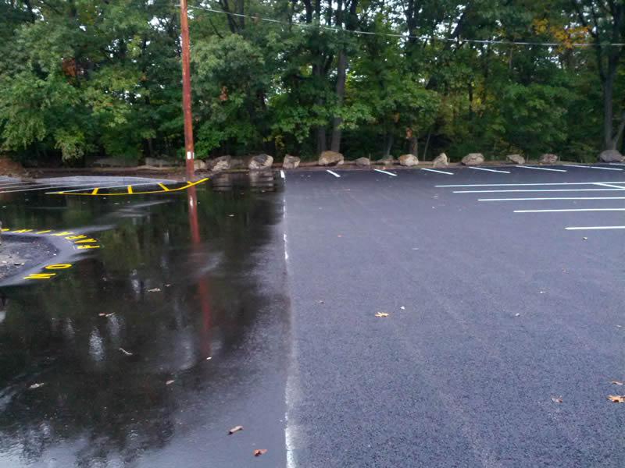
Permeable paving is a range of sustainable materials and techniques with a base and subbase that allow the movement of stormwater through the surface. In addition to reducing runoff, this effectively traps suspended solids and filters pollutants from the water.

Slide 18
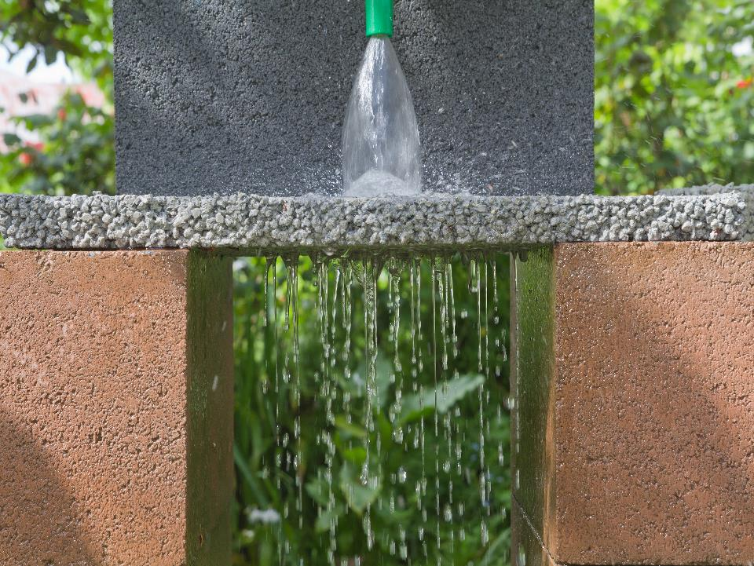

Slide 19
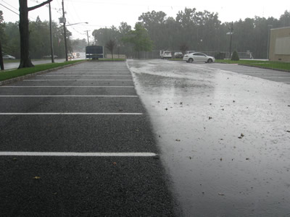
Permeable pavements - a great idea but there are problems
Do not have the tensile and compressive strength of regular pavements
Can clog over time if not maintained properly

Slide 20
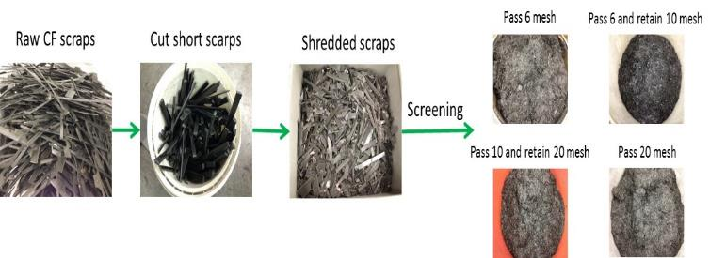
The WSU engineering team developed the process to incorporate carbon fiber into permeable asphalt and concrete
WSU Puyallup developed the toxicity data

Slide 21
New Research funded by Governor Inslee
Evaluating the toxicity of roofing material pollutants carried in stormwater
John Stark
Jen McIntyre
Lisa Rozmyn
Nancy Winters
Taylor Haskins
21

Slide 22
Mapping future pre-spawn mortality hotspots in Puget Sound
NOAA, WSU, USFW

Slide 23
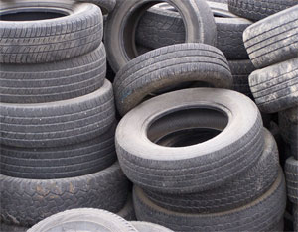
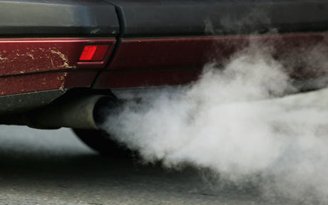
Evaluating the toxicity of vehicle materials (tires, oil, exhaust etc.) McIntyre and Stark

Slide 24
Other Projects

Slide 25
Stormwater Strategic Initiative
Heidi Siegelbaum
Tanyalee Erwin
Stark

Slide 26
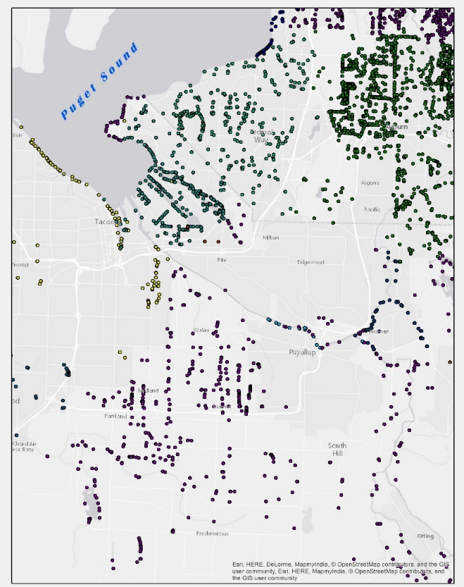
Mapping Stormwater Outfalls
Creating a reliable dataset of permitted
Puget Sound outfall locations
Working with permitted jurisdictions
to improve outfall management
Partnership with Washington Depts. of
Health, Natural Resources and Ecology
Aaron Copado

Slide 27
Developing New WSU ON-LINE LID Training Program with Dept. of Ecology and Herrera Consulting
Working with WSU Global Campus, developing NEW online curriculum program for basic program with on-site hands-on classes to complement
Leveraging community college and other institutional interest (prison systems; veterans affairs Dept.) for curriculum development and work-force training
Jayakaran, Gridley, Siegelbaum, Erwin

Slide 28
Results of our stormwater toxicology studies
Untreated stormwater collected from Seattle freeways is extremely toxic to fish and aquatic invertebrates causing lethal and sublethal effects but running stormwater through bioretention systems (rain gardens) completely eliminates toxicity
Certain roofing materials release toxic levels of metals into stormwater
Tire dust is toxic to aquatic organisms
Coal tar sealants release hydrocarbons at toxic concentrations

Slide 29
Results of our stormwater toxicology studies
PSM is caused by pollutant mixtures in stormwater, but we haven’t identified which pollutants cause this effect
Running SW through bioretention systems eliminates PSM
Boeing’s carbon fiber study --

Slide 30
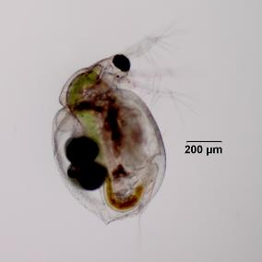
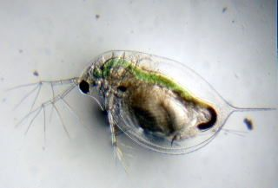
Toxicity studies
Exposed Ceriodaphnia dubia to lab water and lab water run through traditional permeable asphalt and concrete and carbon-fiber modified permeable pavements
Exposed C. dubia to urban stormwater run through traditional permeable asphalt and concrete and carbon-fiber modified permeable pavements

Slide 31
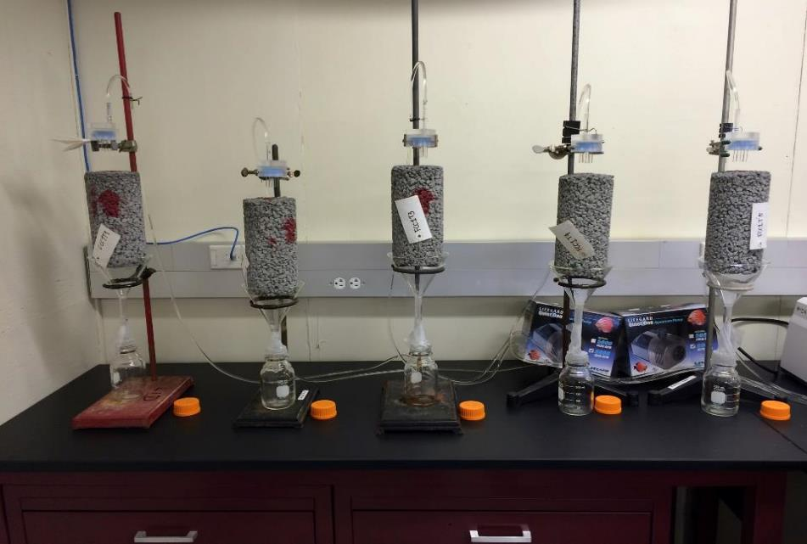
Concrete Columns
Notes:
Concrete

Slide 32
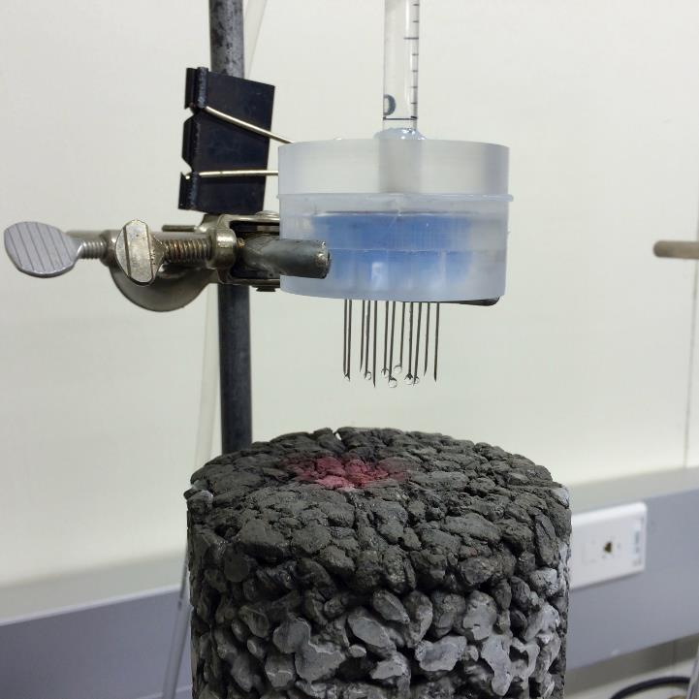
Notes:
Water droplets onto concrete cores

Slide 33
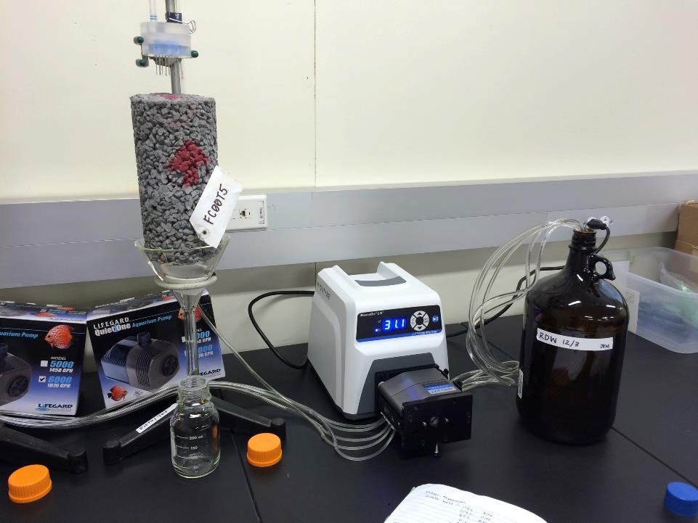
Notes:
One core, peristaltic pump, RDW clean leaching water

Slide 34
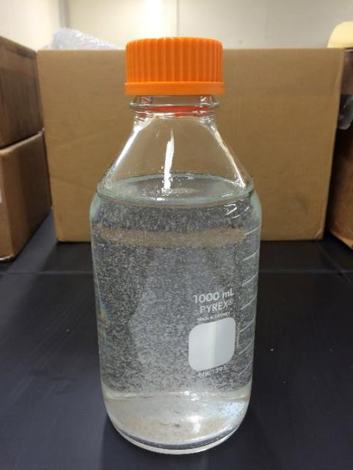
Flocculate in lab leach water from concrete cores

Slide 35
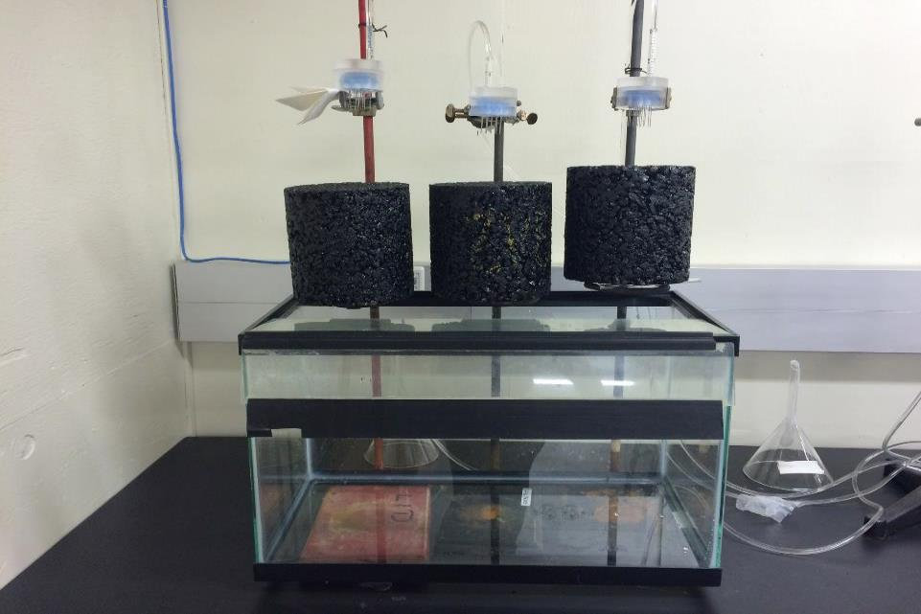
Asphalt columns
Notes:
Asphalt cores

Slide 36
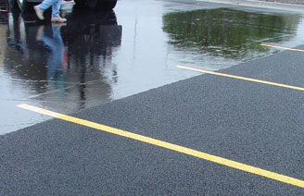
Results
Addition of Boeing’s carbon fiber to both pervious concrete and porous asphalt increased tensile and compressive strength

Slide 37
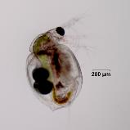
Survival of C. dubia to lab water
Contrtol Con Con+ Pac Pac+

Slide 38
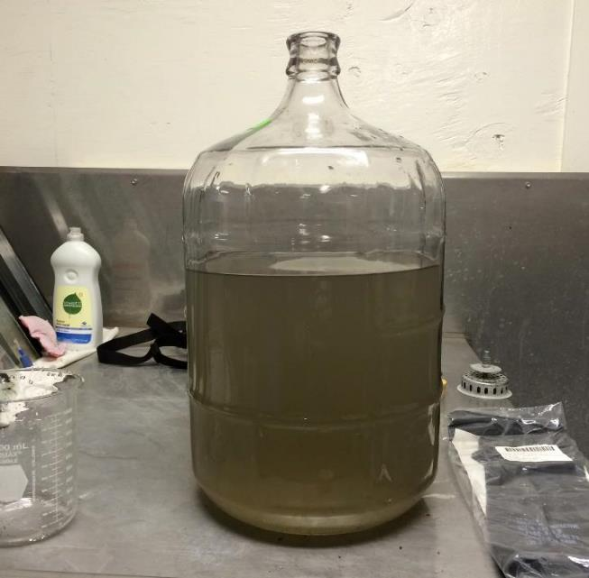
Seattle Freeway runoff
Notes:
Highway runoff

Slide 39
Survival of C. dubia exposed to urban runoff

Slide 40
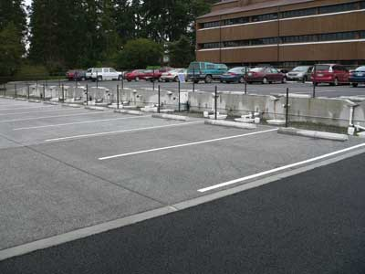
Conclusions
Addition of Boeing’s carbon fiber to pervious concrete and porous asphalt resulted in increased tensile and compressive properties and improved infiltration
Lab water that leached through pervious concrete was toxic to C. dubia. This was due to a large increase in pH. In future studies, pH adjustment needs to be considered as well.
Lab water leaching through porous asphalt was also toxic to C. dubia.
Addition of carbon fiber to porous asphalt reduced toxicity to C. dubia.

Slide 41
Conclusions continued
Stormwater collected from a Seattle freeway was not toxic to C. dubia due to frequent rain events.
But when stormwater was run through the asphalt columns, it was more toxic than lab water perhaps pulling out more toxic compounds. The addition of carbon fiber reduced this toxicity.

Slide 42
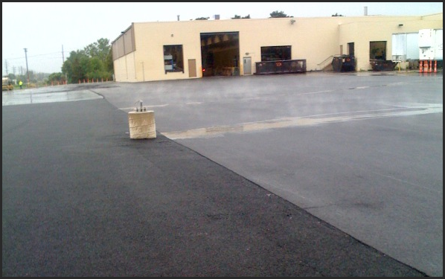
Next steps
Work on pH issues with toxicity to Daphniids
Evaluate toxicity to salmon and other fish species
Evaluate stormwater from a series of rain events
Evaluate leachate toxicity over time – multiple water samples run through the columns

Slide 43
Stormwater Research Partners
PUYALLUP
WSU/WSC Stormwater Supporters
Bullitt Foundation
Notes:
I'm going to start with research partners and funders. As a graduate student I tended to find this part boring, but as a working scientist, I see how critical partnerships are. Most of the work I will show today was the result of collaborations between WSU, USFWS, NOAA-F, and - for the adult salmon studies - The Suquamish Tribe. Most of the funding was from EPA R10 with support from NOAA, Sea Grant, and the RFF.
'It takes a village' to do this kind of research.

Slide 44
Questions?

