Slide 1
Lisa Rozmyn
September 21, 2018

Slide 2
Stormwater Regulations – A Brief History
How many waters do we have and why is it regulated so many ways?
The good, the bad, and oh, crap, is that river on fire again?
Water as the “Blind men and the elephant” and the problems from differing perspective and locations.

Slide 3
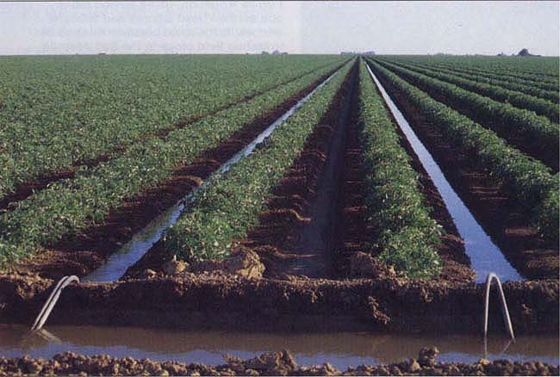
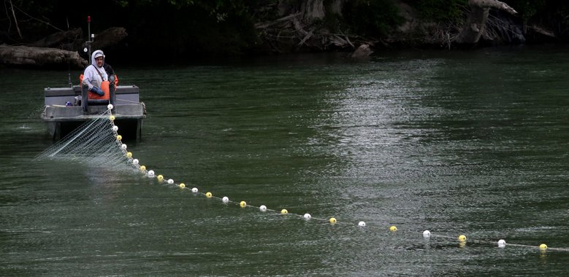
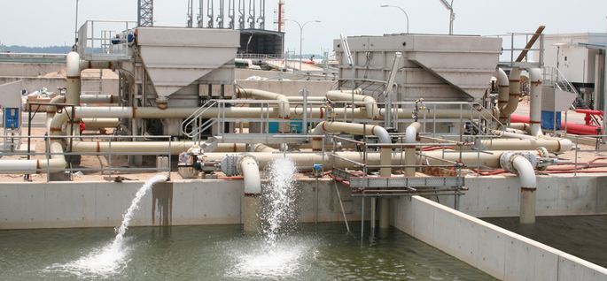
ONE WATER - Uses

Slide 4
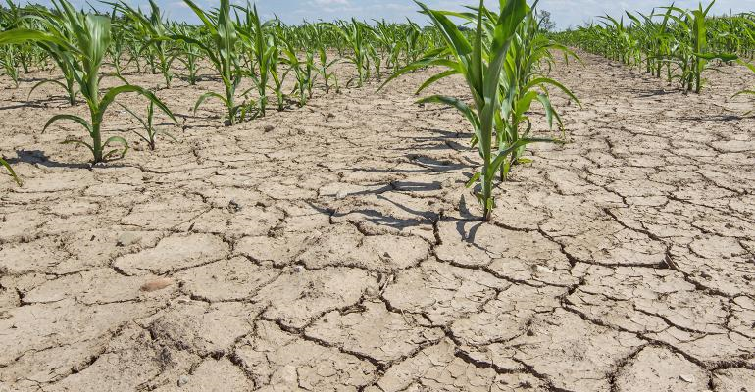
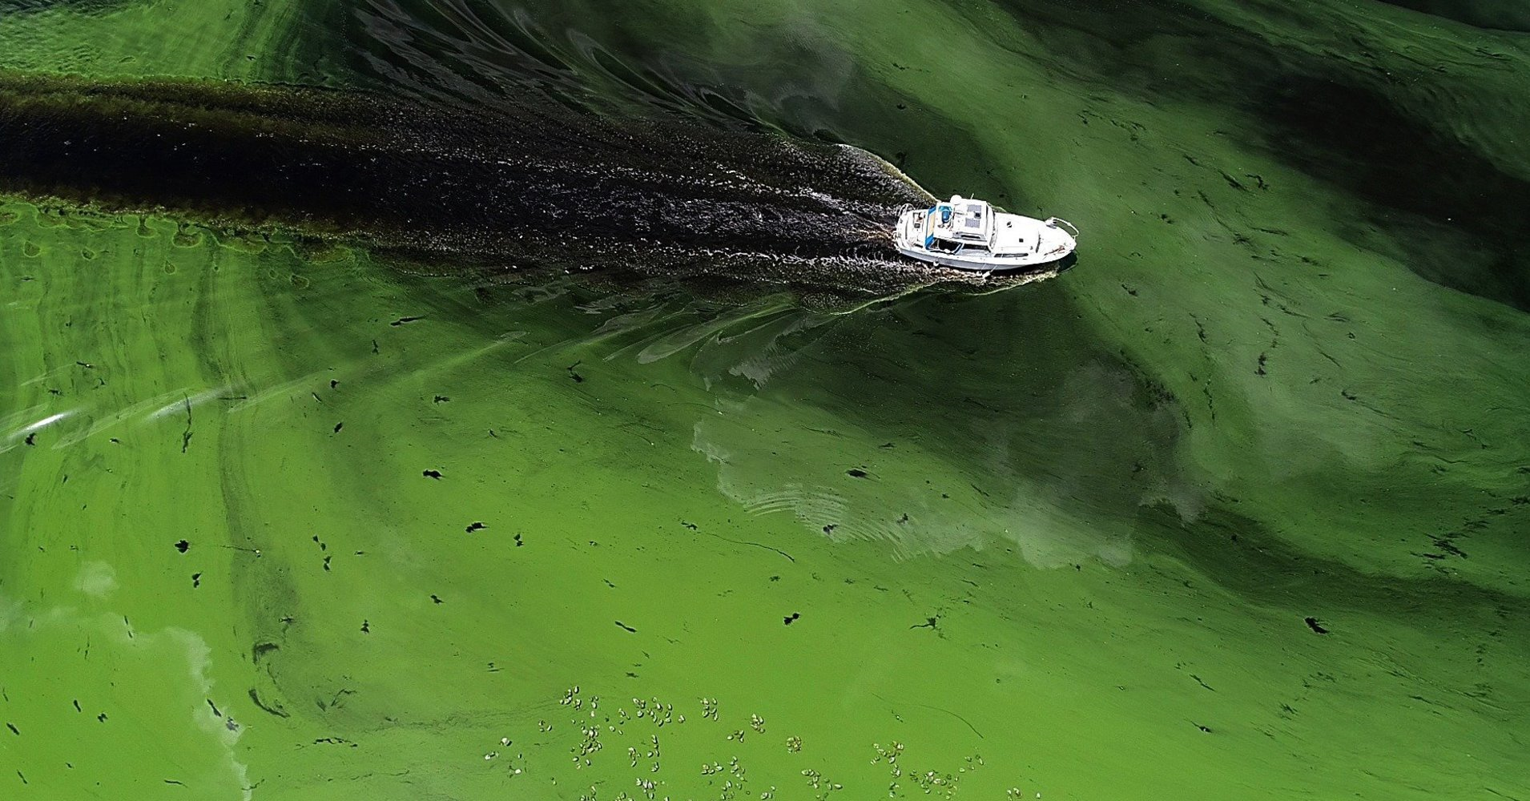
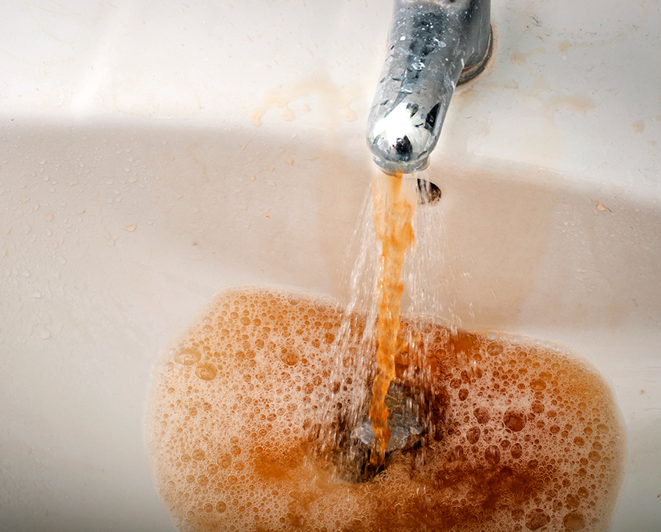
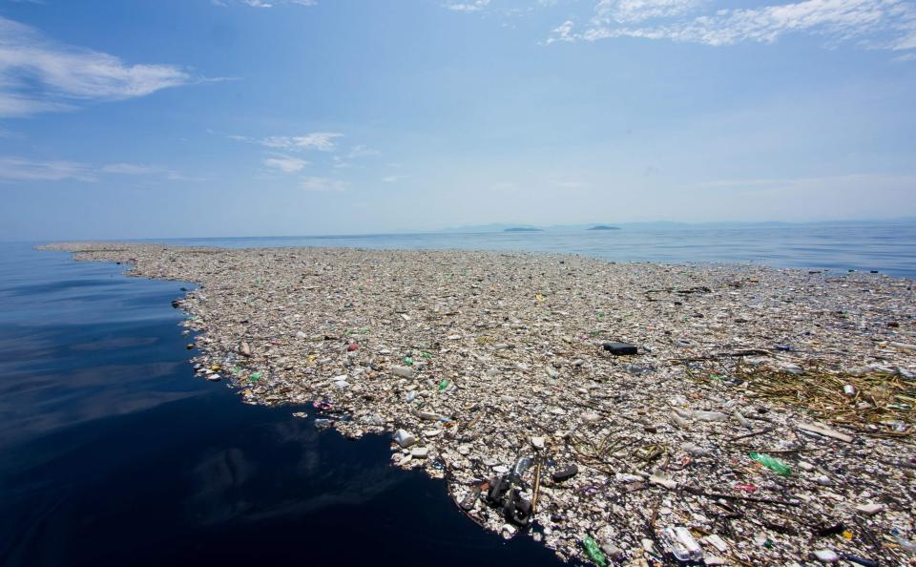
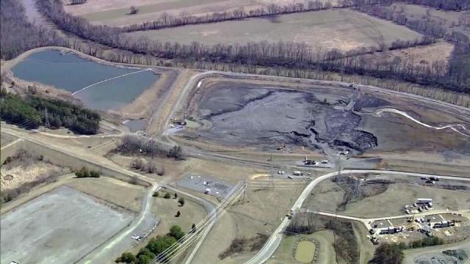
One Water – Climate Change and Abuses

Slide 5
How Did We Get Here?
Waters of the US
Nonpoint vs Point Source Pollution
Clean Water Act Section 402
General vs Individual Permits
Presumptive vs Demonstrative Approach
Permits overview: industrial, sand and gravel, boatyard, muni, etc
Municipal Permits – more in depth
Challenges, Resources, Issues…

Slide 6
Water Regulation – The Beginning
Rivers and Harbors Act of 1899 - Navigation
Oldest federal environmental law in the US
Refuse Act – Don’t dump anything that would impede navigation, unless you have a permit
Federal Water Pollution Control Act of 1948
Passed under President Truman to address the concerns surrounding water pollution and contaminants.
Public awareness and concern for water pollution and control necessitated amending the original Act, which resulted in the Clean Water Act of 1972.

Slide 7
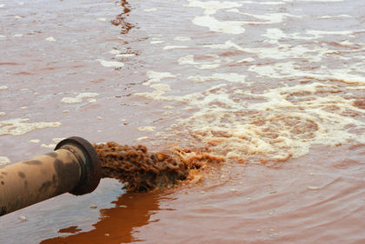
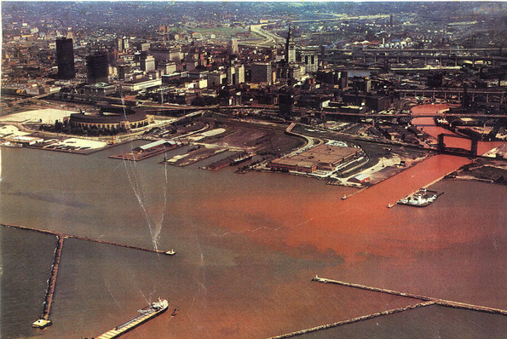
Public Awareness – Disco wasn’t the only bad thing about the 70’s

Slide 8
Definition of “Waters of the US”
The term waters of the United States means: (1) For purposes of the Clean Water Act, 33 U.S.C. 1251 et. seq. and its implementing regulations, subject to the exclusions in paragraph (o)(2) of this section, the term ‘‘waters of the United States’’ means: (i) All waters which are currently used, were used in the past, or may be susceptible to use in interstate or foreign commerce, including all waters which are subject to the ebb and flow of the tide; (ii) All interstate waters, including interstate wetlands; (iii) The territorial seas; (iv) All impoundments of waters otherwise identified as waters of the United States under this section; (v) All tributaries, as defined in paragraph (o)(3)(iii) of this section, of waters identified in paragraphs (o)(1)(i) through (iii) of this section; (vi) All waters adjacent to a water identified in paragraphs (o)(1)(i) through (v) of this section, including wetlands, ponds, lakes, oxbows, impoundments, and similar waters; (vii) All waters in paragraphs (o)(1)(vii)(A) through (E) of this section where they are determined, on a case-specific basis, to have a significant nexus to a water identified in paragraphs (o)(1)(i) through (iii) of this section. The waters identified in each of paragraphs (o)(1)(vii)(A) through (E) of this section are similarly situated and shall be combined, for purposes of a significant nexus analysis, in the watershed that drains to the nearest water identified in paragraphs (o)(1)(i) through (iii) of this section. Waters identified in this paragraph shall not be combined with waters identified in paragraph (o)(1)(vi) of this section when performing a significant nexus analysis. If waters identified in this paragraph are also an adjacent water under paragraph (o)(1)(vi), they are an adjacent water and no case-specific significant nexus analysis is required.

Slide 9
Nonpoint vs Point Source (NPDES)
The term "nonpoint source" is defined to mean any source of water pollution that does not meet the legal definition of "point source" in section 502(14) of the Clean Water Act.
That definition states:
The term "point source" means any discernible, confined and discrete conveyance, including but not limited to any pipe, ditch, channel, tunnel, conduit, well, discrete fissure, container, rolling stock, concentrated animal feeding operation, or vessel or other floating craft, from which pollutants are or may be discharged. This term does not include agricultural storm water discharges and return flows from irrigated agriculture.

Slide 10
Clean Water Act Section 402 - NPDES
Animal Feeding Operations (AFOs)
Aquaculture
Biosolids
Forest Roads
Industrial Wastewater
Municipal Wastewater
Combined Sewer Overflows (CSOs)
Integrated Planning
Peak Flows
Sanitary Sewer Overflows (SSOs)
National Pretreatment Program
Standards and Requirements
Roles and Responsibilities
Events, Trainings, and Publications
Pesticide Applications
Stormwater
Stormwater Discharges from Construction Activities
Stormwater Discharges from Industrial Activities
Stormwater Discharges from Municipal Sources
Stormwater Discharges from Transportation Sources
Oil and Gas Stormwater Permitting
Stormwater Rules and Notices
Vessels Incidental Discharge Permitting
Whole Effluent Toxicity (WET)

Slide 11
Stormwater Permits vs NPDES Permits with a stormwater component
Municipal
Phase I, Phase II, Secondary
Industrial
Construction
WSDOT
Boatyard
Sand and Gravel
Bridge and Ferry Terminal Washing
Concentrated Animal Feeding Operation (CAFO)
Fresh Fruit Packing
Upland Fin Fish
Vessel Deconstruction
Winery

Slide 12
General vs Individual Permits
One Permit, many permittees
Same requirements for all
5 year cycle, mostly on time, often appealed.
One Permit for each facility
Requirments vary depending on facility type, process, wastes, discharge locations, etc
5 year permit, usually goes over
Rarely appealed

Slide 13
Municipal Permit
Phase I
Issued in 1995
medium and large cities or counties with populations of 100,000
There are approximately 750 Phase I MS4s in the US
6 Phase I, 2 secondary in WA
Phase II – Western and Eastern WA
Issued in 2007
Small cities and counties within the “census defined urbanized area”
Approximately 6700 Phase II in US
67 Phase II WWA, 24 in EWA

Slide 14
MS4 Phase I Stormwater Management Program
10 Elements
Legal Authority
MS4 Mapping and Documentation
Coordination
Public Involvement and Participation
Controlling Runoff from New Development, Redevelopment and Construction Sites 16
Structural Stormwater Controls
Source Control Program for Existing Development
Illicit Connections and Illicit Discharges Detection and Elimination
Operations and Maintenance Program
Education and Outreach Program

Slide 15
MS4 – Phase II Stormwater Management Program
5 Elements
Public Education and Outreach
Public Involvement (public notice)
IDDE (mapping and source control)
Controlling runoff from New Development, Redevelopment and Construction Sites (LID Requirements)
Municipal Operations and Maintenance

Slide 16
Tribal Requirements Under CWA
Must tribes comply with the CWA?
YES
The only difference is that they are not subject to state regulations in those states where EPA has delegated authority.
Tribes CAN take on CWA permitting, but none in WA have
Some tribes in WA have written their own water quality standards

Slide 17
CWA does NOT include protections for ground water
Tribes are not subject to the State Waste Discharge Permit that covers discharges to ground
No federal or state regulatory mechanism to protect ground water on tribal lands.

Slide 18
Reissuance of Municipal Permits & Manuals
Municipal – Phase I, Phase II Western Eastern WA
Public comment period for all three Aug 15 – Nov 14, 2018
Stormwater Management Manuals being updated
Public comment also ends Nov 14, 2018
Workshops and Hearings:
Sept. 27, 2018 – Moses Lake, WA, 9:30 a.m.
Oct. 2, 2018 – Mount Vernon, WA, 10 a.m.
Oct. 10, 2018 – Seattle, WA, 10 a.m.
Oct. 30, 2018 – DuPont, WA, 10 a.m.
Nov. 1, 2018 – Eastern WA Webinar, 10 a.m.
Nov. 6, 2018 – Western WA Webinar, 1:30 p.m.
Nov. 7, 2018 – Vancouver, WA, 10 a.m.

Slide 19
Reissuance of the Industrial Stormwater General Permit
Current permit expires December 31, 2019
Listening sessions:
Union Gap Sept. 25 at the Ecology Regional Office
Spokane Sept. 26 Ecology Regional Office
Renton Oct. 16 Renton Community Center
Lacey Oct. 23 Ecology Headquarters
Bellingham Oct. 24, Ecology Field Office
Statewide webinar Oct. 3
Ecology will answer questions and accept feedback until Nov 26. Then draft permit out spring 2019 for public comment
Final permit issued Nov 2019, effective Jan. 1, 2020

Slide 20
Contact the WSC
Washington Stormwater Center
Offering stormwater management assistance to Washington NPDES permittees and stormwater managers by providing access to information, training, permit assistance, research and emerging technologies.
www.wastormwatercenter.org
1-855-WASTORM

