Slide 1
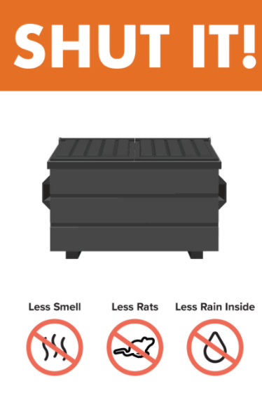
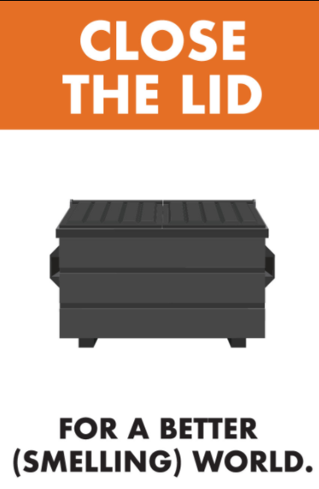
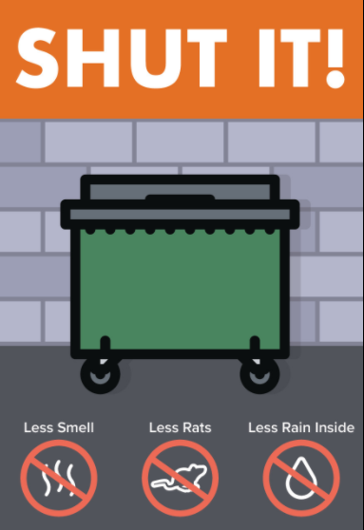
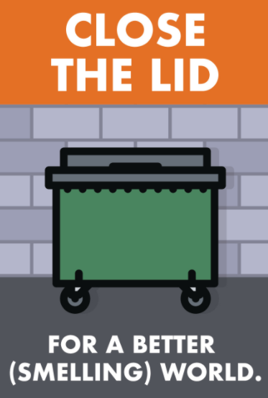
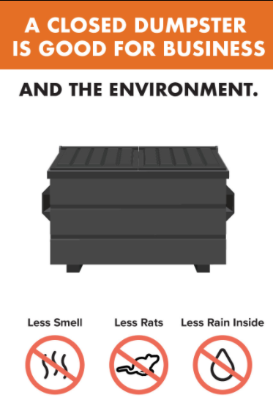
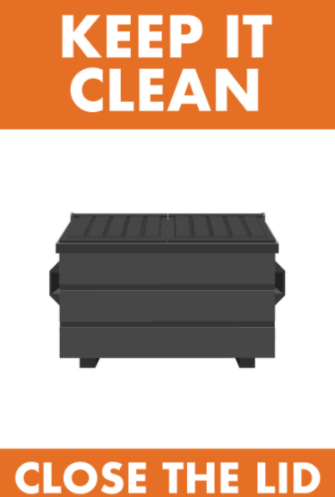
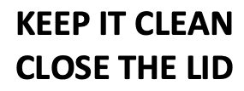
WHO & WHAT – BACKGROUND (N=20)

Slide 2
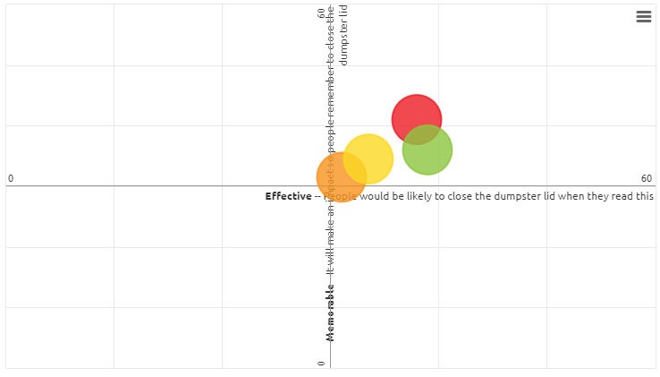
EFFECTIVE & MEMORABLE
“Shut it” is considered slightly more memorable
“Keep it clean” is considered slightly more effective

Slide 3
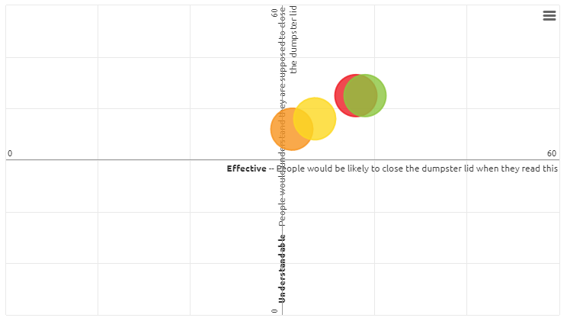
EFFECTIVE & UNDERSTANDABLE
“Keep it clean” is considered slightly more effective – And equal to “Shut it” on memorable

Slide 4
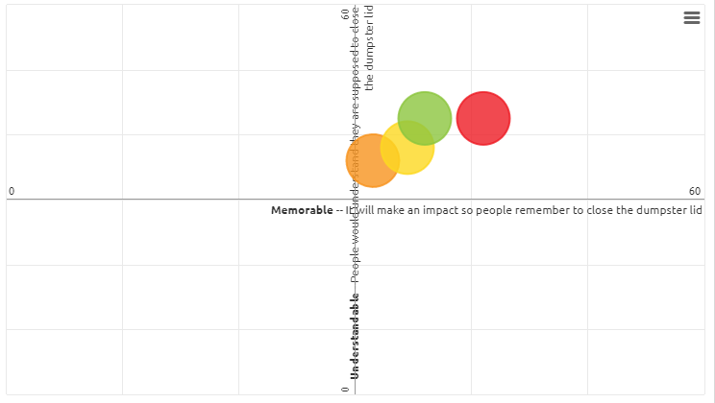
MEMORABLE & UNDERSTANDABLE
“Shut it” is slightly more memorable – And equal to “Keep it clean” on understandable

Slide 5
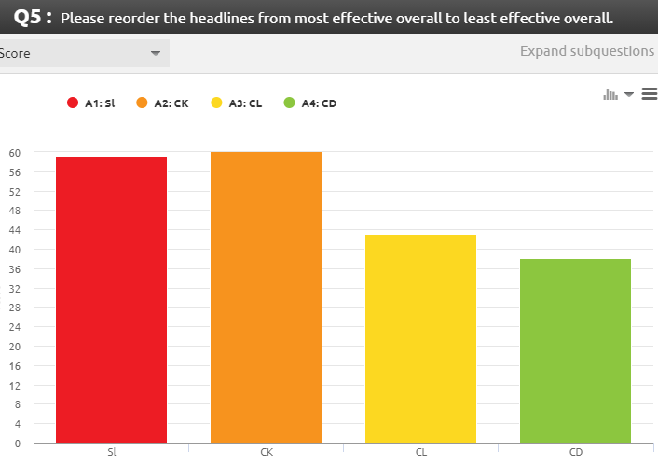
EFFECTIVENESS RANKING ALSO SHOWS “KEEP IT CLEAN” SLIGHTLY MORE EFFECTIVE THAN “SHUT IT”

Slide 6
