Slide 1
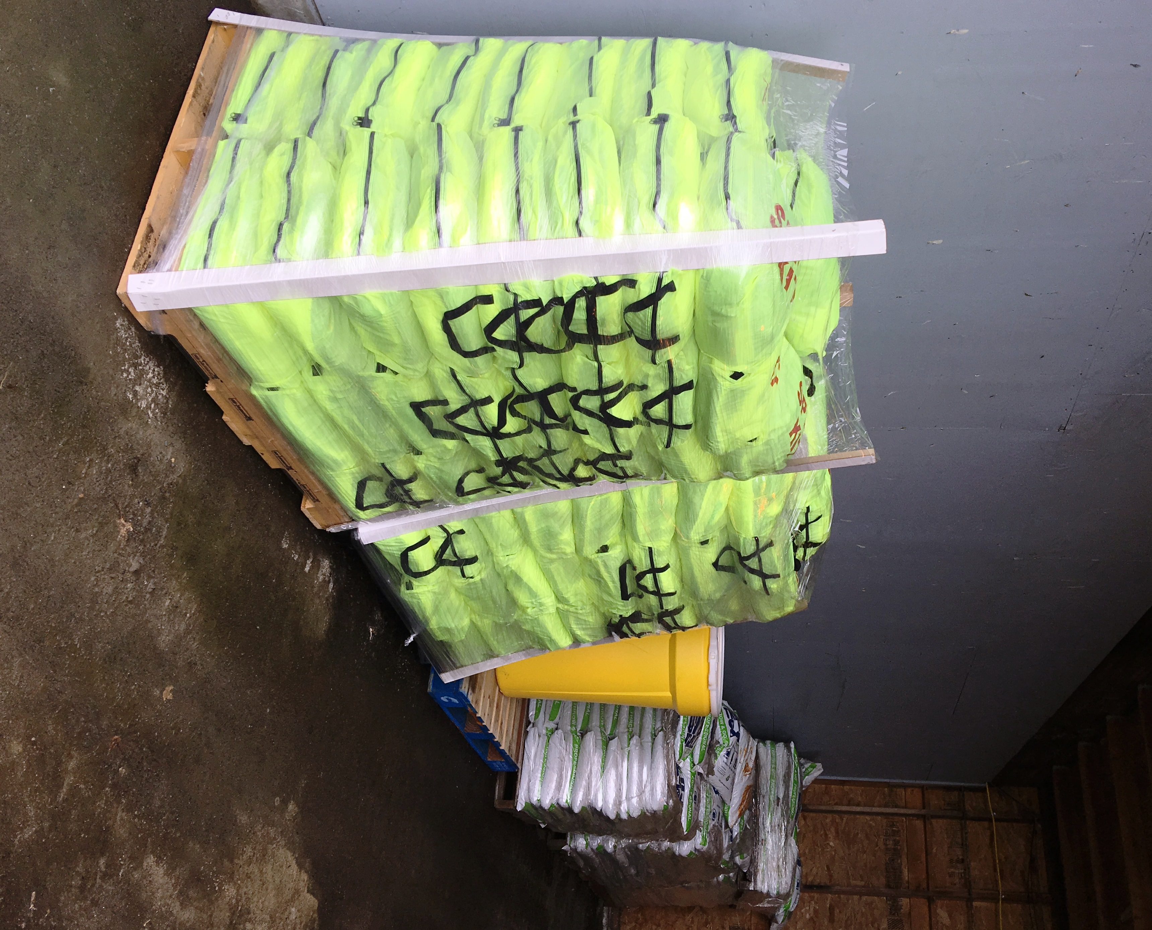
Internal Cooperation
Spill Kit Management

Slide 2
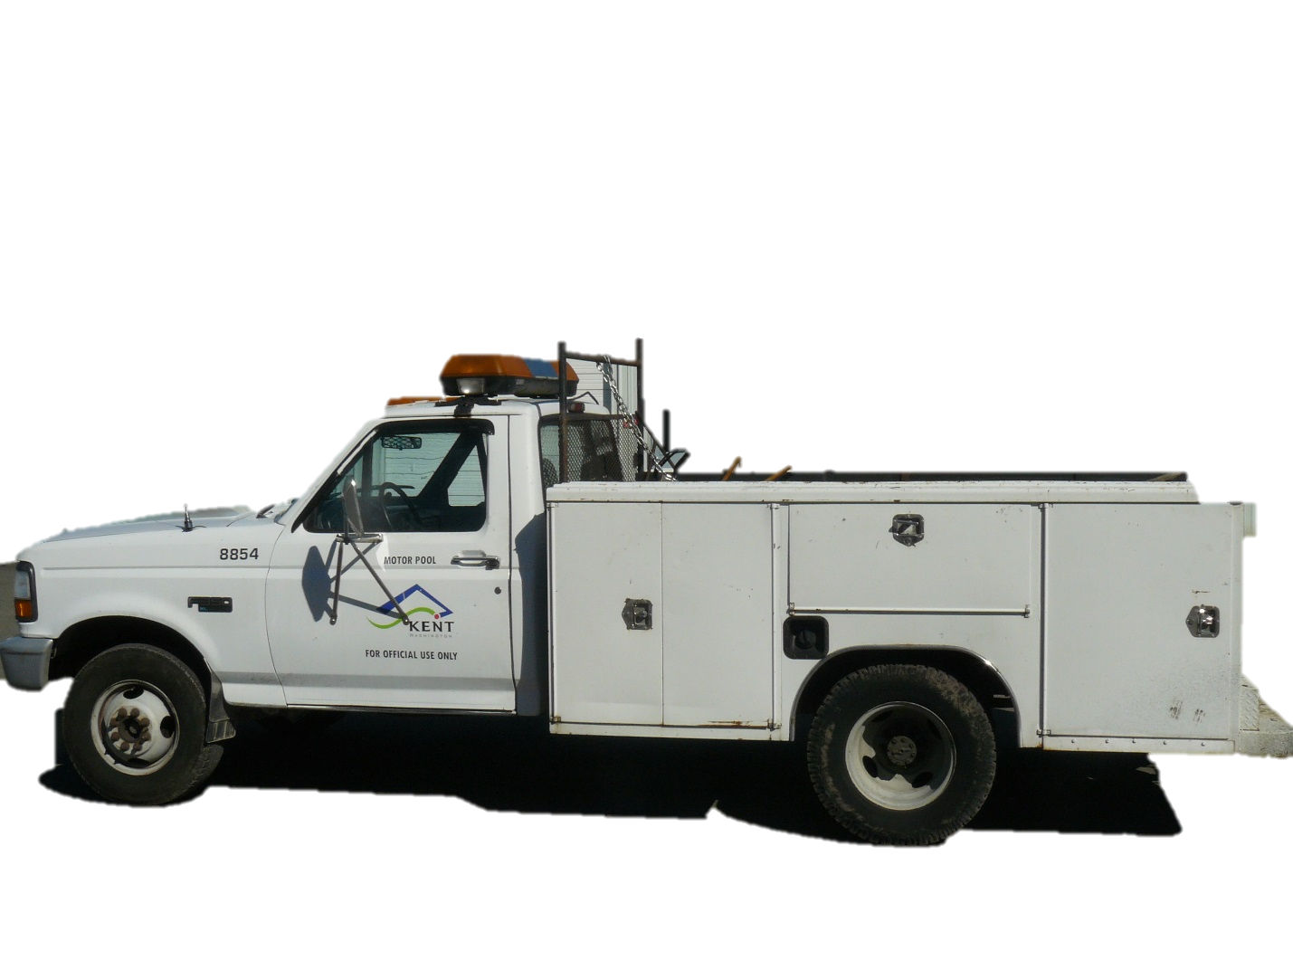
After spill kit use, restock your kit.

Slide 3
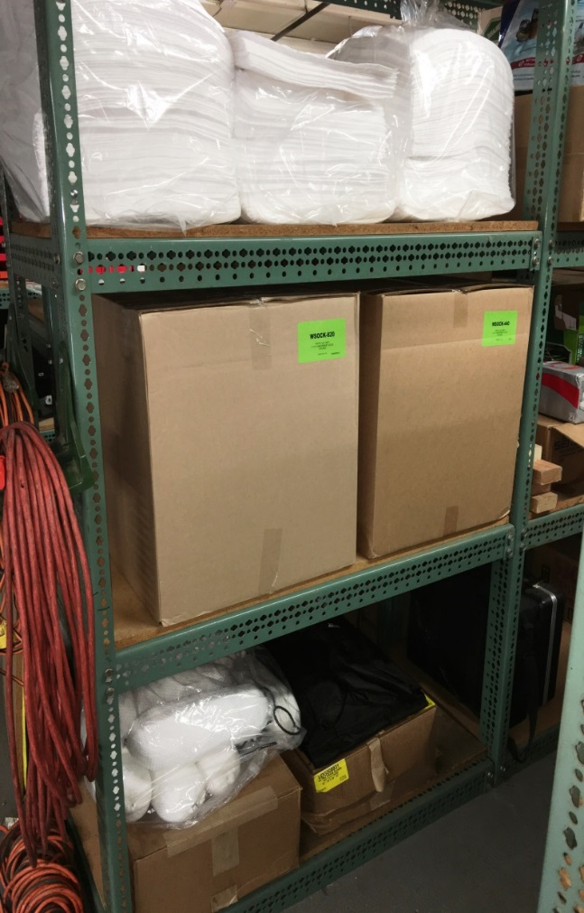
Spill response materials can be found clearly marked out at Shed Row
Supplies can also be obtained from the Warehouse

Slide 4
Mechanics check spill kits to ensure that they are adequately stocked during routine maintenance checks.

Slide 5
Ensure that spill kits have a label and laminated spill response instructions.

Slide 7
Our Police are also now carrying spill response kits!

