Slide 1
Phase II Municipal Stormwater Permit
Illicit Discharge Detection and Elimination
Recordkeeping (S5.C.5g)

Slide 2
IDDE Recordkeeping
Maintenance
Eliminate Active Spills
Spill Clean-Up
Maintain Public Infrastructure
IDDE
Education & Technical Assistance
Inspection & Investigation
Regulatory Documentation

Slide 4
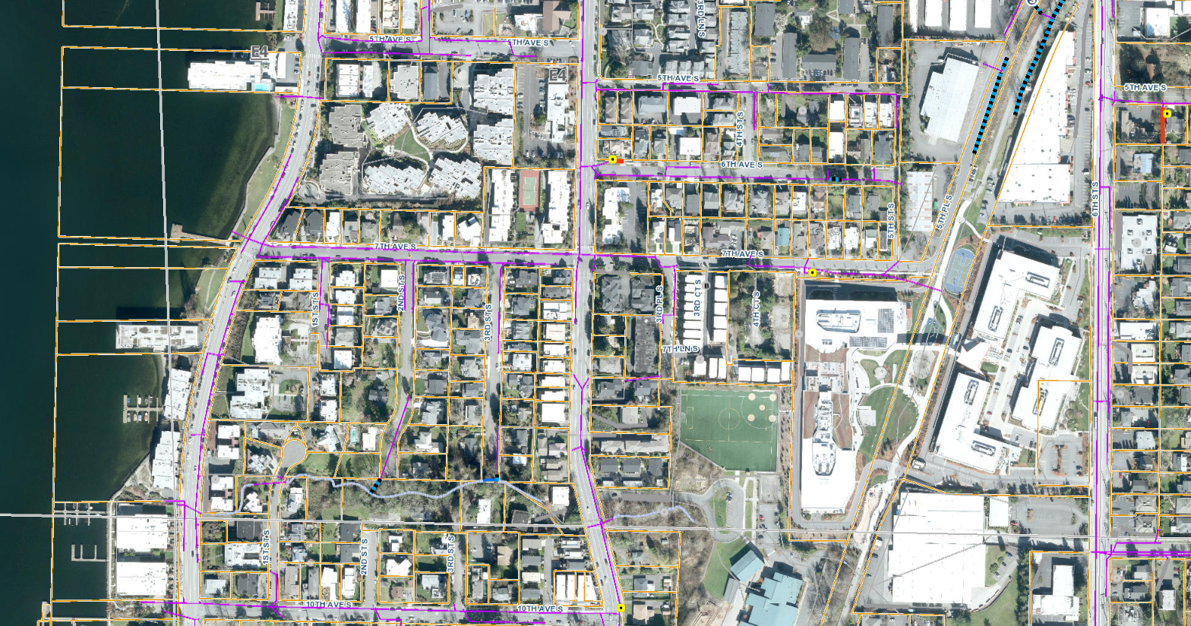

Slide 5
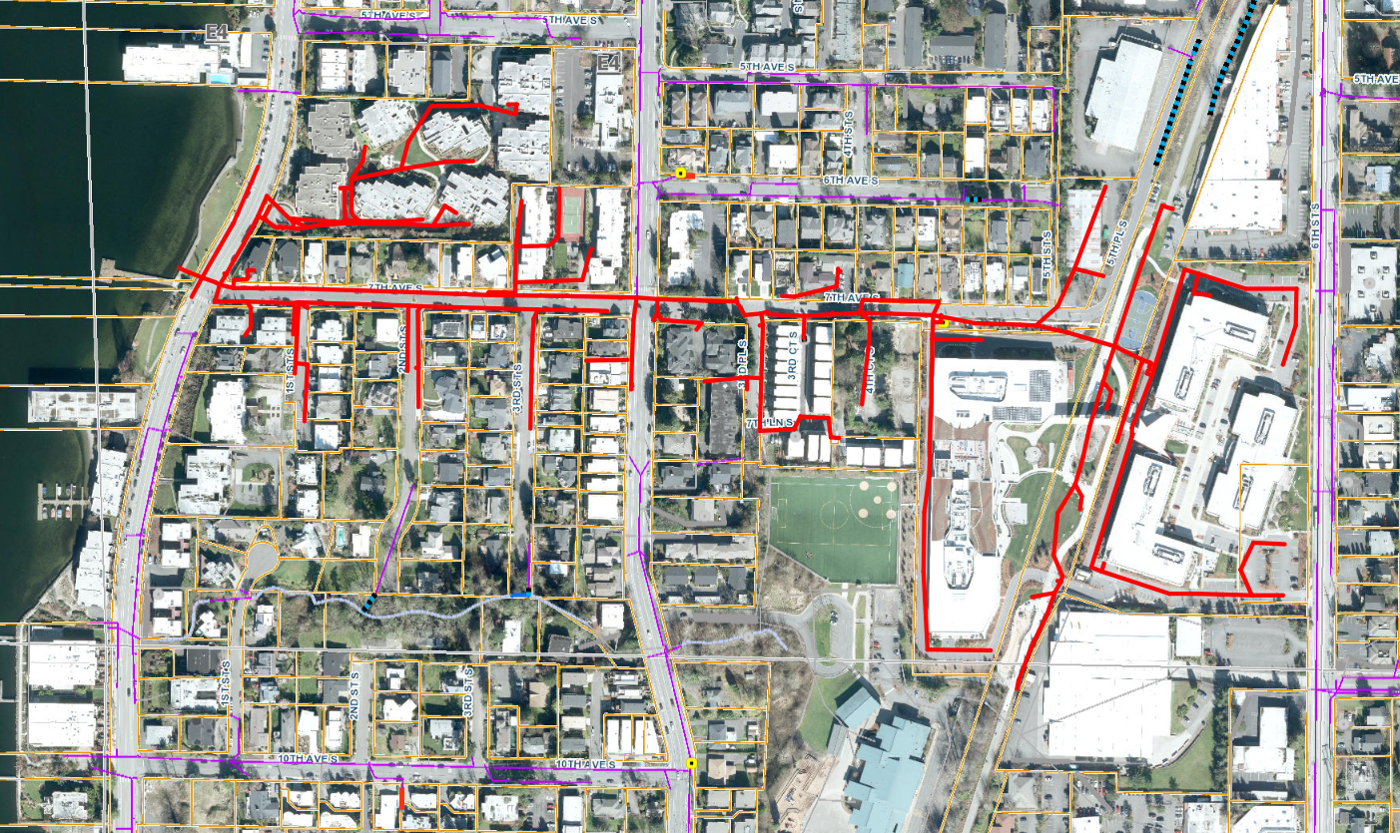

Slide 6
Lucity

Slide 7
Energov

Slide 8
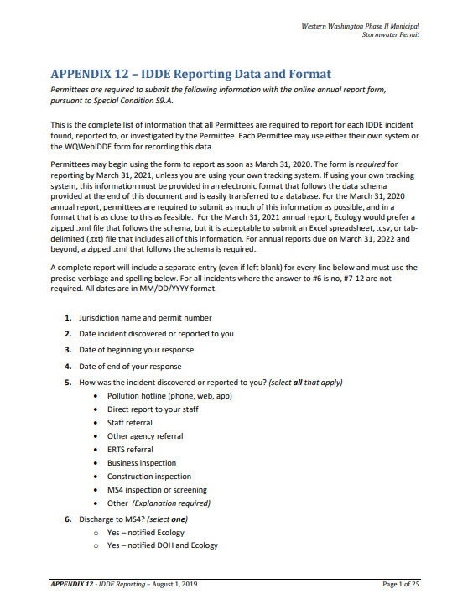
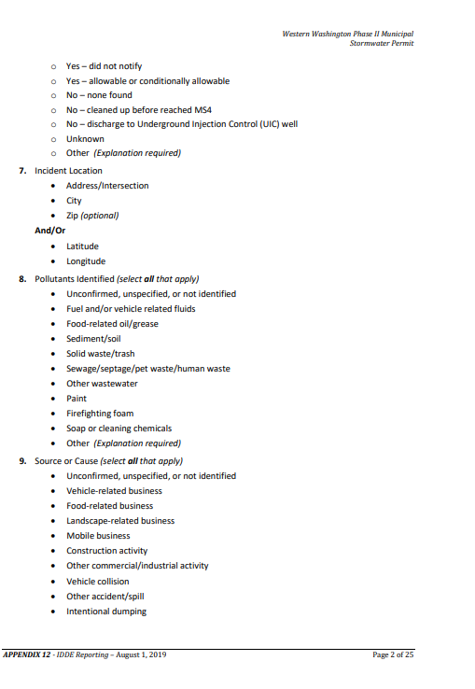
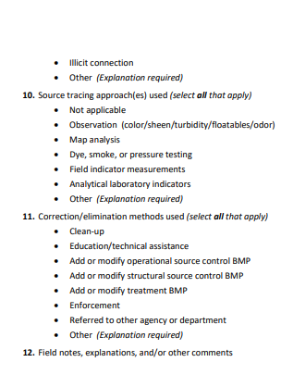

Slide 9
Energov

Slide 10
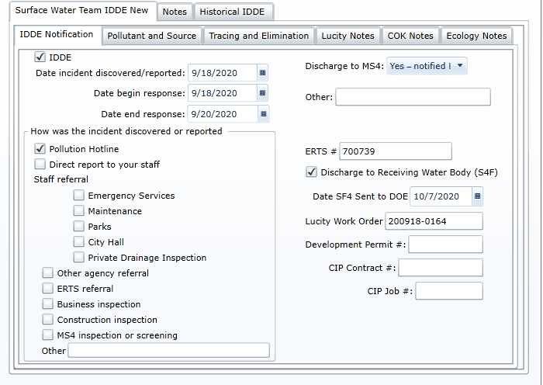

Slide 12
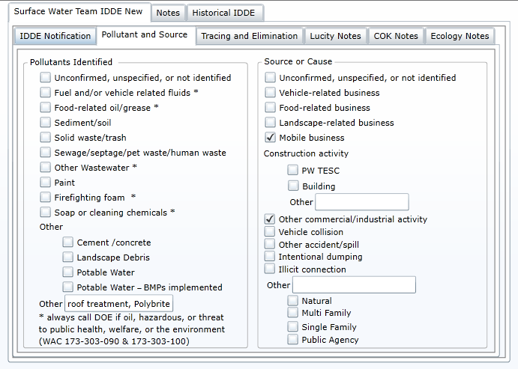

Slide 15
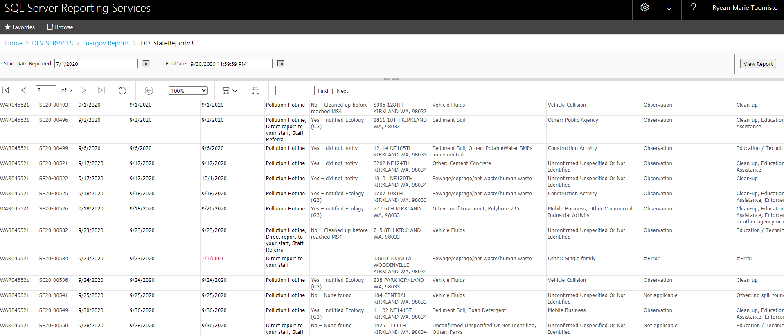

Slide 16
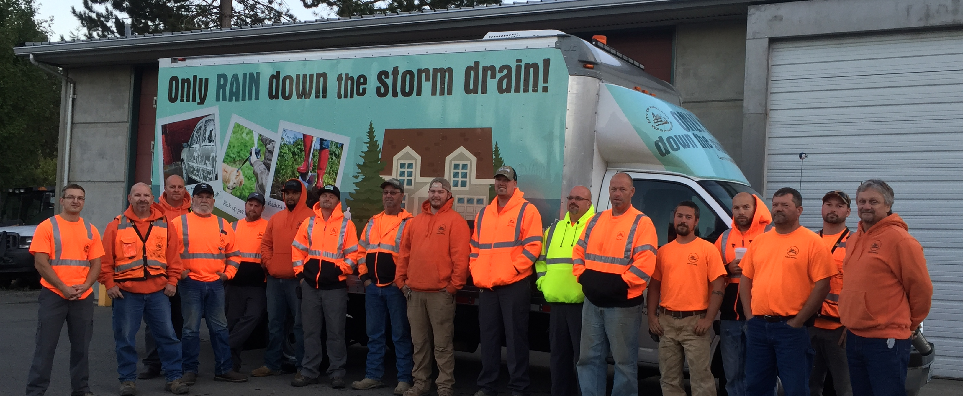
Ryean-Marie Tuomisto
Rtuomisto@kirklandwa.gov

